Slide 1
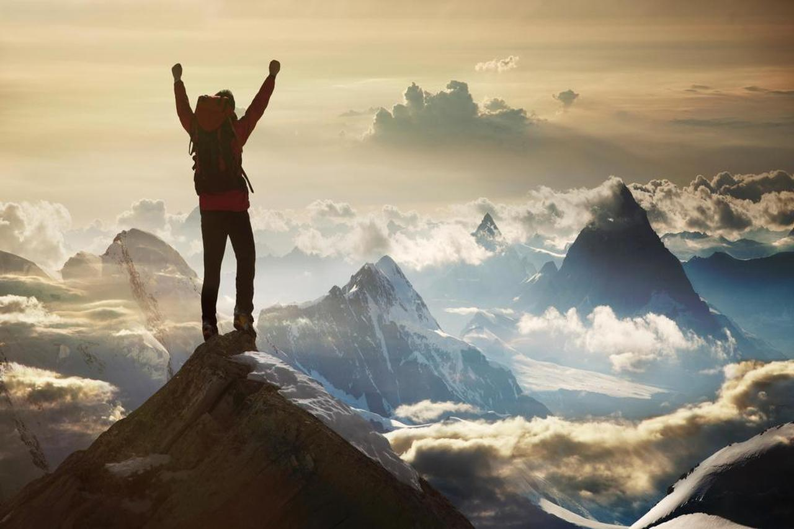
Bronze DofE at Beechen Cliff School 2021-22
BEECHEN CLIFF
Physics Department
The DofE’s a life-changing adventure you don’t want to miss.
It’s about going the extra mile ­– learning new skills for work and life, getting fitter, making a difference and broadening your horizons.

Slide 2
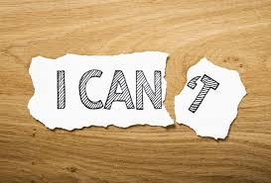
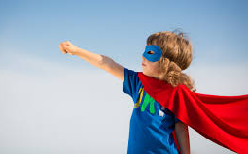
BEECHEN CLIFF
Physics Department
What do participants get out of DofE?
Self-confidence
New relationships
Time management
Communication & problem solving skills
Awareness of their own potential
Independence
New talents and skills
A sense of identity
Self-belief
Leadership & teamwork
Understanding of own strengths and weaknesses

Slide 3
BEECHEN CLIFF
Physics Department
History
Boys scheme started in 1956
Girls scheme started in 1958
At any one time over 450,000 young people are taking part in the Award in over 120 countries

Slide 4
Award Structure
BEECHEN CLIFF
Physics Department
Bronze | Silver | Gold
Year 9 | Year 10 | Year 12
All awards must be completed by the participant's 25th birthday.

Slide 5
BEECHEN CLIFF
Physics Department
What does the DofE programme involve?
Volunteering
Helping someone, your community or the environment
Physical Recreation Section
Becoming fitter through sport, dance or fitness activities
Skills Section
Developing existing talents or trying something new
Expedition Section
Planning, training for and completing an adventurous journey

Slide 6
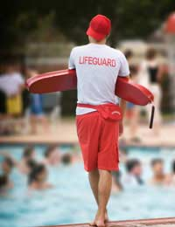
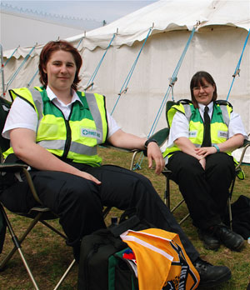
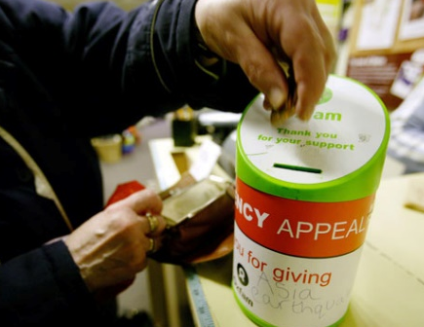
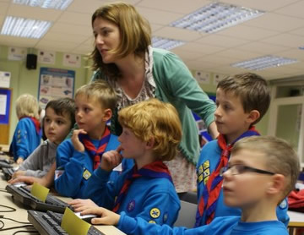
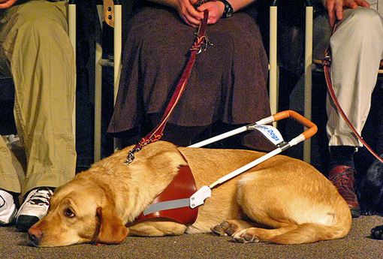
BEECHEN CLIFF
Physics Department
Volunteering
• Community Action & awareness raising
• Working with Environment or animals
• Helping people, a charity or community organisation
• Coaching or teaching

Slide 7
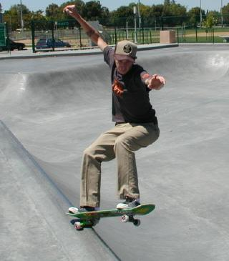
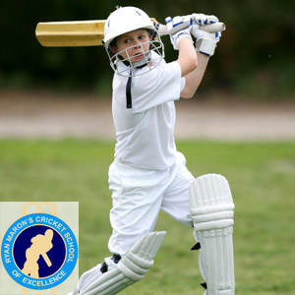
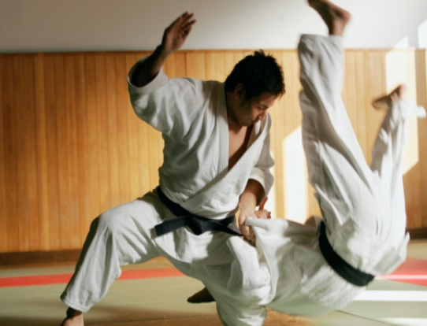
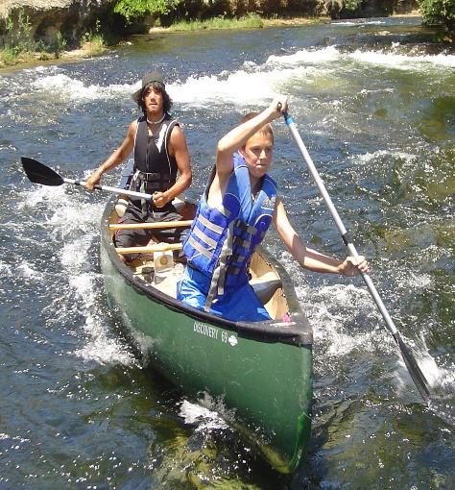
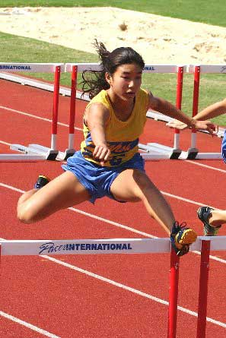
BEECHEN CLIFF
Physics Department
Physical Recreation
• Dance
• Racket Sports
• Extreme sports
• Fitness
• Martial arts
• Individual sports
• Team sports
• Water Sports

Slide 8
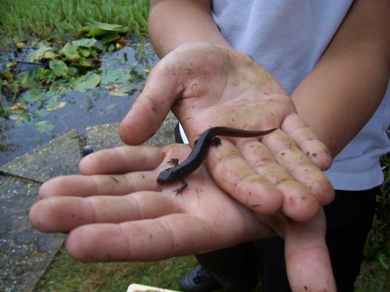
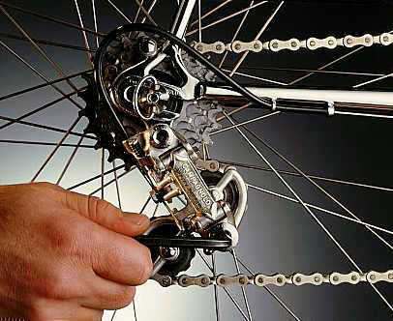
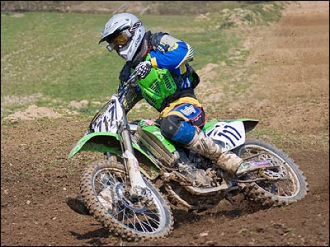
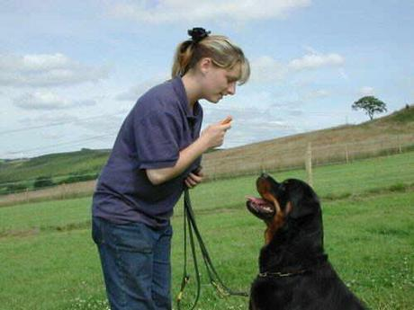
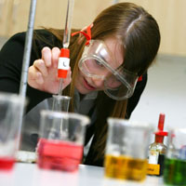
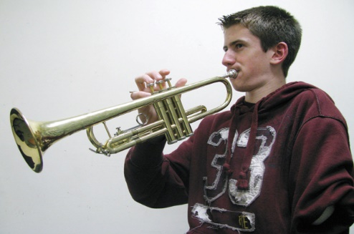
BEECHEN CLIFF
Physics Department
Skills
Natural world
Music
Life skills
Sports
Performance arts
Media & communication
Learning & collecting
Care of animals
Science & technology
Creative Arts
x

Slide 9
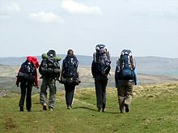
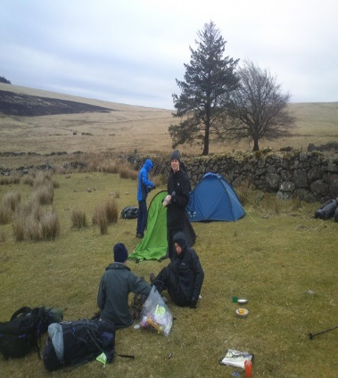
BEECHEN CLIFF
Physics Department
EXPEDITION
At BCS the Bronze expedition programme is designed to be inclusive, exciting, fun and comprehensive. Covering all aspects of expedition training.
The programme 2021-22
Fortnightly sessions in school starting after the October break.
A local walk March 2022
Practice Expedition April 2022
Qualifying Expedition June 2022
x

Slide 10
BEECHEN CLIFF
Physics Department
Time Frame - Bronze
Service
Skills
Physical Recreation
Expedition
Plan and
undertake a
two-day
venture,
with overnight camp
3 months
3 months
3 months
+ further three months in any of the above
Based on an average of 1-2 hours per week

Slide 11
When you sign up….
BEECHEN CLIFF
Physics Department
You will be receive an online eDofE account and support from BCS and the local DofE centre.
Please give your son’s email address on the enrolment form.
Regular training sessions throughout the year.
2 Expeditions and a day walk
Ongoing support with edofe to complete the Award.
Log book
T-shirt
Some transport
Group kit
Full training including First Aid
Staffing costs
Campsite costs
Licencing fee

Slide 12
Implications of Covid.
BEECHEN CLIFF
Physics Department
The DofE organisation produces regular updates for students and parents via their website and edofe accounts. The Award was adapted continually during lockdown to make it easier for students to complete their activities and gain a certificate of achievement.
For many young people it provides a positive focus during a potentially stressful time.
At BCS we are dedicated to providing the full Award and will adapt where necessary, adhering to school policies and safety associated with the conoravirus. In the very unlikely event that all expedition training needs to be cancelled students will be offered a certificate of achievement for the other sections of the award.
A ‘pay as you go’ payment system has been set up thereby you only pay for the opportunities that your son can access.

Slide 13
What next?
BEECHEN CLIFF
Physics Department
Students can enrol onto the Award in September 2021. Ms Fox will be emailing parents letters and the necessary paperwork to complete.
If you have any questions please email Ms Fox jfox@beechencliff.org.uk DofE manager.

Slide 14
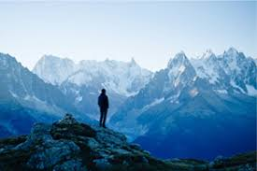
OF ALL THE PATHS YOU TAKE IN LIFE, MAKE SURE A FEW OF THEM ARE DIRT. JOHN MUIR
BEECHEN CLIFF
Physics Department
.

