Slide 1
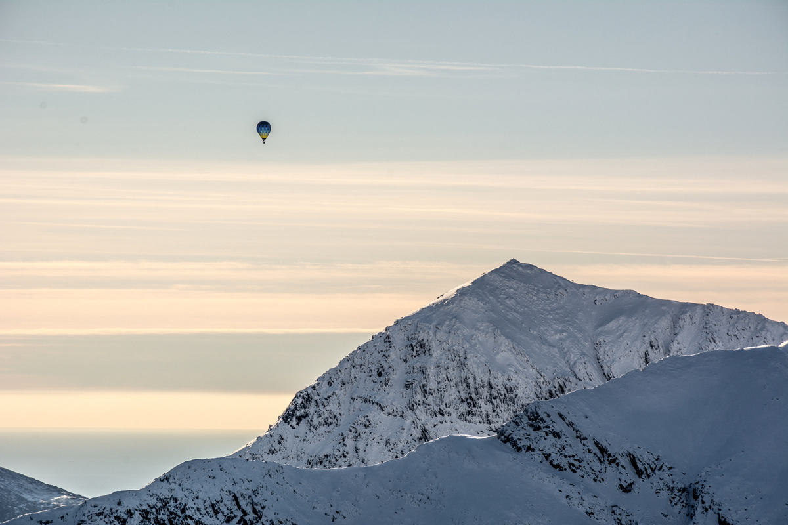
Welsh winter mountaineering club trip
Tom Moat
Dave Brewer
Dave Murphy
Hazel Hughes
Hugo Lopez
Rough itinerary
Expectation / kit
Questions

Slide 2
https://www.youtube.com/watch?v=88HGSryMPuE
https://www.youtube.com/watch?v=VykqqONDFO8

Slide 3
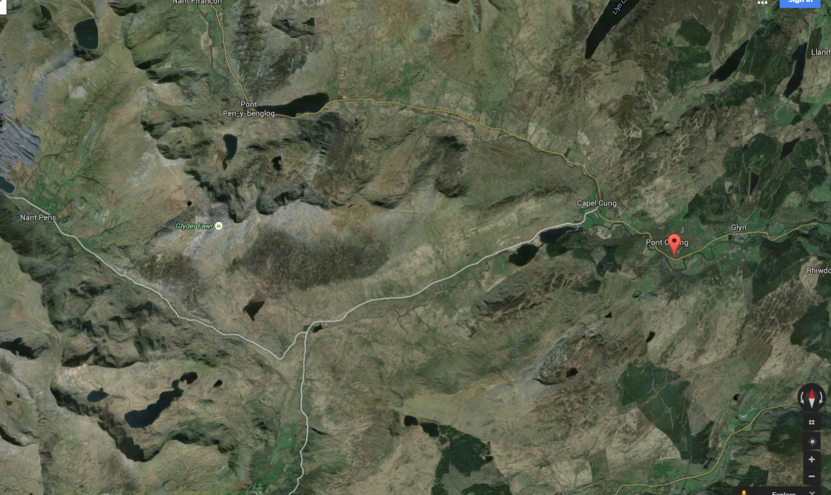
Tryfan / Glyders / Idwal
Hut acomodation
Snowdon Horsehoe
1 mile
Tyn y Coed ( local pub )

Slide 4
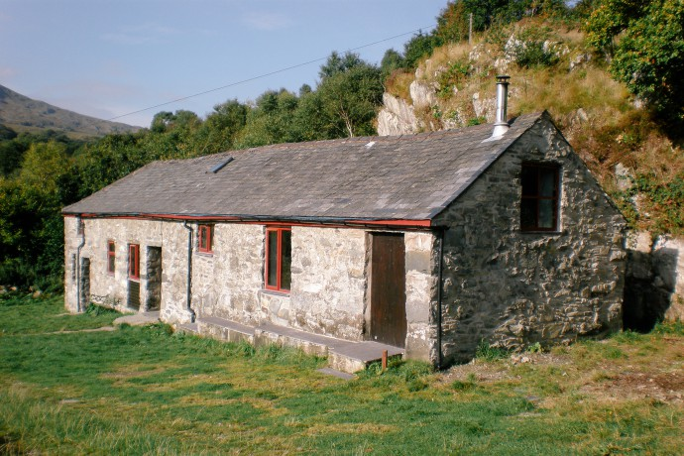
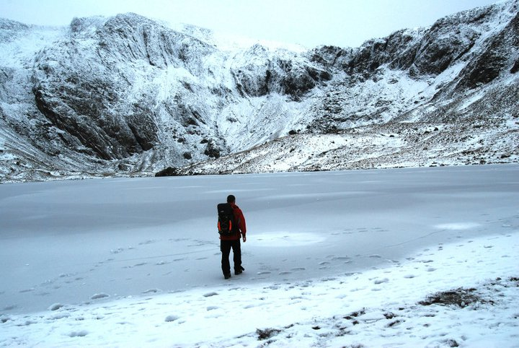
North London Mountaineering club hut
Sleeps 30 on 'alpine style' bunks
8 gas stoves for cooking ( we will mostly eat out anyway ).
You need a sleeping bag. No tent / mattress, no stove.
15 minute drive to Idwal ( route of descent taken last June marked on )
Food:
Similar to previous trips:
One night pub, one night fish and chips, one night cook at the hut. There are stoves and we will have more time in the evening so if you particularly keen on cooking there is an option to do so.
Again, bring cash for the food.

Slide 5
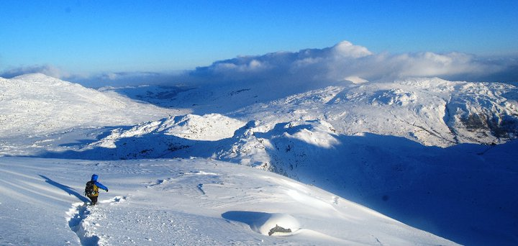
Friday
0800 meet at BCS. Depart in 2 minibuses. Have 2 bags - a day bag which is packed for an afternoon on the hill so that we can get going as soon as we arrive, a second with kit for the evening that we can unpack later on. Don't forget a headtorch!!
1300 arrive at the hut.
Afternoon out locally.

Slide 6
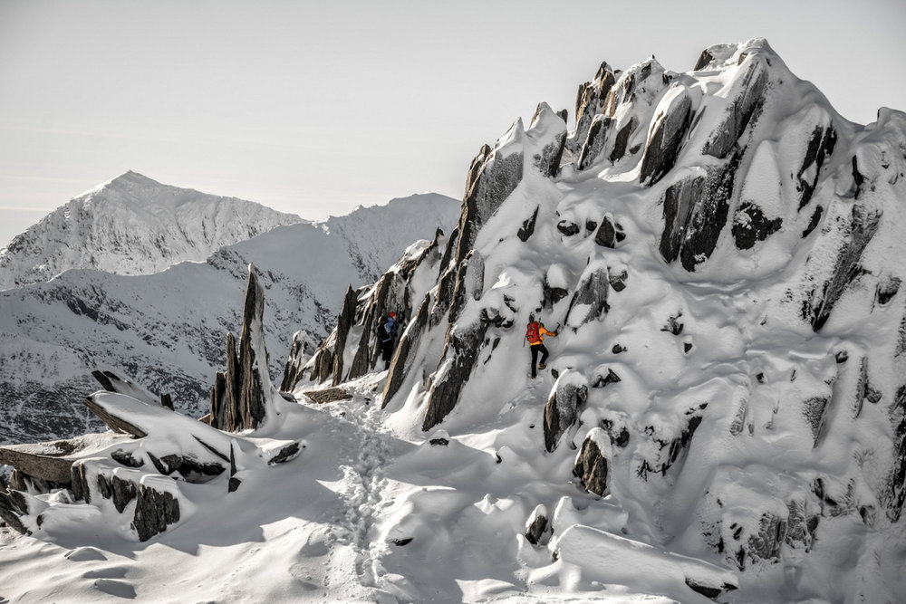
Saturday / Sunday - full days mountaineering. These could be ridge scrambling, hiking, introduction to techniques and equipment needed for snow and ice climbing, and some winter mountaineering routes where possible.
Glyder Fawr, last week
Snowdon

Slide 7
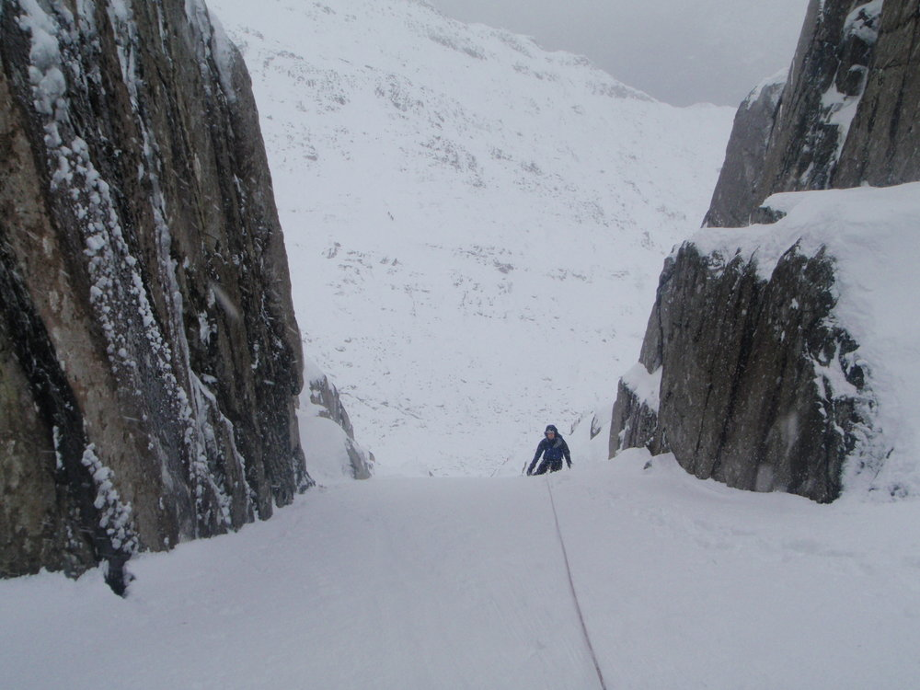
snow gullies are a good opportunity to learn how to walk in crampons, and key skills such as ice axe arrest

Slide 8
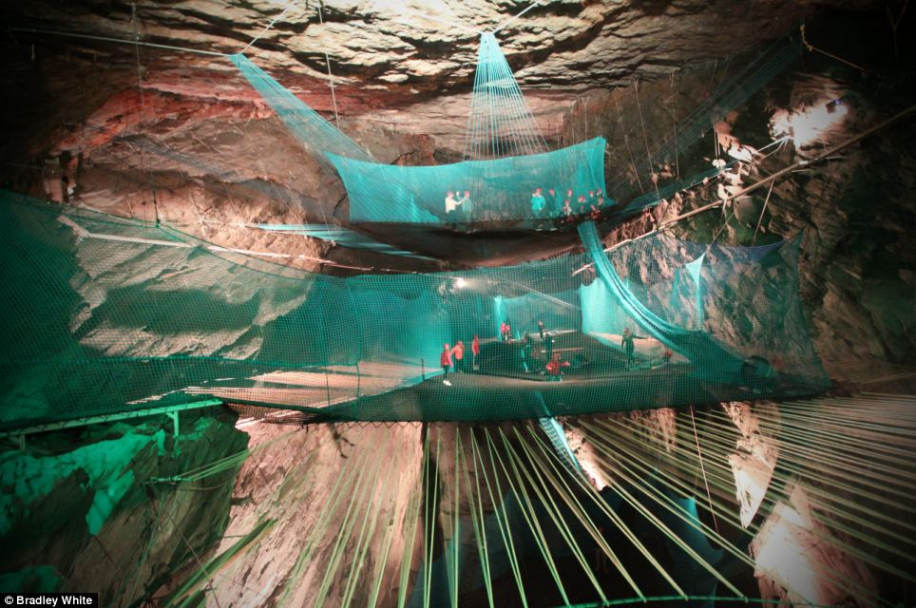
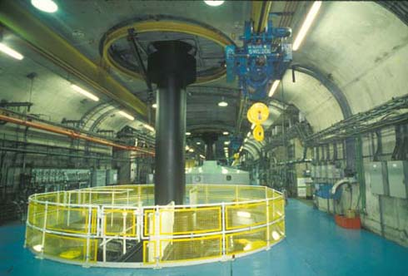
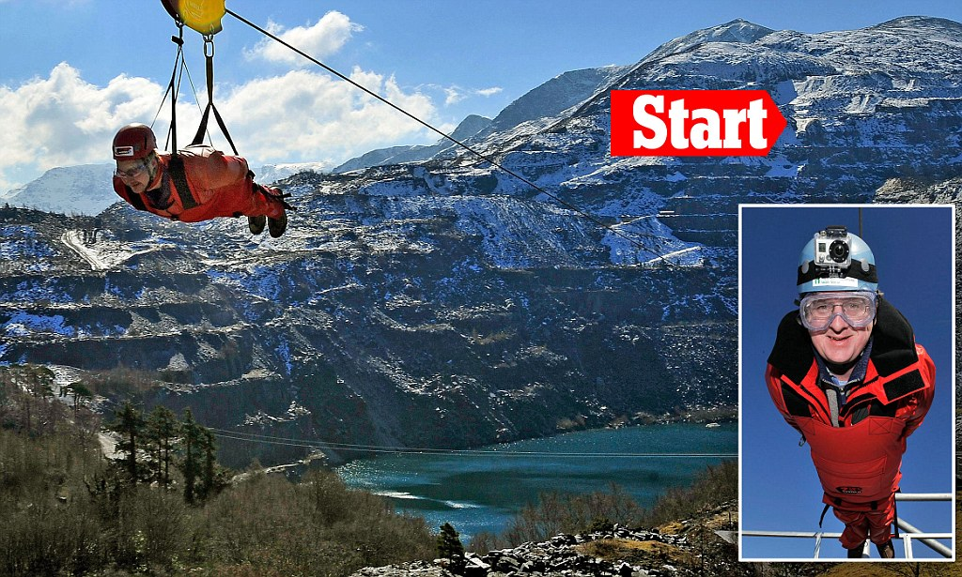
Monday
Get up early. Morning out, tidy the barn and then head home at lunchtime.
It is important to recognise that the itinerary is totally flexible based on conditions / weather. An open mind and an adventurous spirit will help!!
Wet weather options:
Dinorwig power station
Indoor trampoline
Zip world
( all not included in price - bring money if interested )

Slide 9
Snowdonias 3000ft summits
Daysack – capable of carrying;
· Sturdy pair of walking boots
· Spare fleece/jumper
· Spare base layer (long sleeved shirt)
· Waterproof jacket and trousers
· Trousers (If wearing shorts)
· Sun hat (Baseball cap) / sun glasses
· Hat and gloves ( it can get surprisingly cold )
· Survival bag*
· Water bottle ( 2 litres )
· Sun cream
· Whistle
· Day food, sandwiches, chocolate etc.
· Spare laces
· Personal 1st aid kit
· Midge repellent / net
· Camera
Campsite.
· Wash kit
· Sleeping bag*
· Tent* ( between 2 )
· Rollmat*
· Stove ( between 2 )
· Insect repellent ( more! )
· Cutlery, mug, bowl and/or plate
· Spare clothing (don't over do it we are only away three nights)
· Food for the evenings and on the hill. To include hot drinks of your choice. (We will be able to replenish food there)
· Torch
· Money
· Camera
· Trainers
· Pack of cards, ipod, book (It could be wet)
The school will provide tents, fuel and stoves. Items asterixed* on the kit list can also be provided. Please try to keep kit to a minimum to save room on the bus.
Group kit: ( School to provide )
First Aid kits
Ropes / harnesses / helmets / any climbing kit
Group shelters

Slide 10
key points for kit:
·Lots of pairs of gloves - no need to be expensive. If desperate, marigolds are surprisingly waterproof.
·Headtorch with spare batteries. We WILL be out in the dark at some point.
·Layers. Lots of layers. Thermals, rugby / sports tops / hoodies etc.
·Big jacket over the top of everything
·Water bottle / thermos flask
·Lots of snack food - 5000ish calories per day! We will go to the shops to stock up, but maybe not until Saturday afternoon.
·Boots - rigid to accept crampons ( better for scrambling too )
·Sleeping bag, not tent / roll mat / stove needed
·We will do dinner collectively ( ie. pub / fish and chips ). If there are groups of you who would rather save money, you can cook in the hut.
·For breakfasts, get into groups to sort food / tea / coffee.
·Walking poles?

